Slide 1
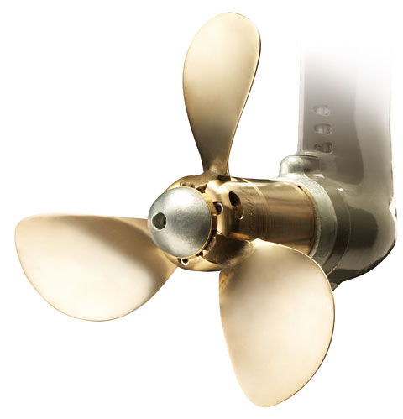
HEADLAND ENGINEERING
Flexofold Propeller AUSTRALIA FOLDING PROPELLER FOR SAILBOATS

Slide 2
Location of production facilities
Vejle, Denmark

Slide 3
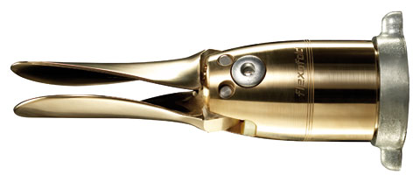
What we do…
Flexofold develops, designs and manufacture low drag folding propellers for sailboats and multihull yachts
Specialist with a single purpose factory
Lean organization and very efficient manufacturing setup
The propellers are supplied in Australia by Headland Enginering

Slide 4
The Flexofold history
Introduction of 2-bl. Flexofold Composite
Pittman Award + DAME spec. mention
Founded by Jack Skrydstrup
Introduction of the 2-blade Flexofold
Aquired by Yanmar Europe
Moving to Vejle + new CNC
Introduction of the 4-blade Flexofold
Closing of Flexofold USA – new setup
Opening of Flexofold USA
Introduction of the 3-blade Flexofold
1992
1996
2002
2005
2012
2015
2015
2016
2017

Slide 5
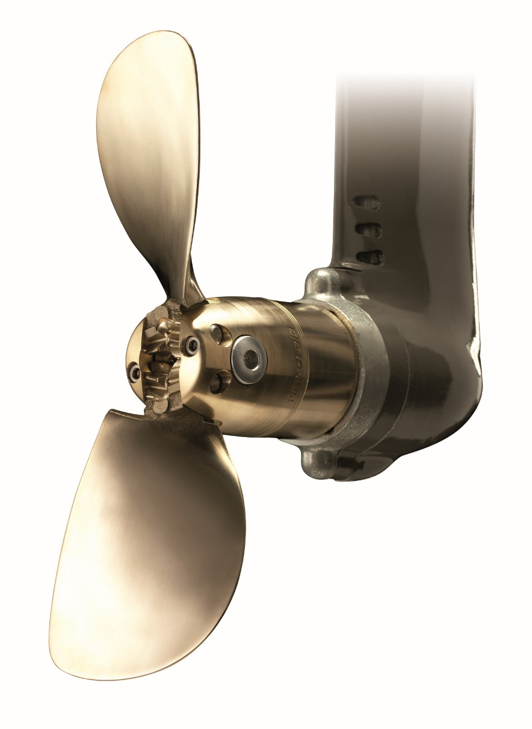
The idea about folding propellers

Slide 6
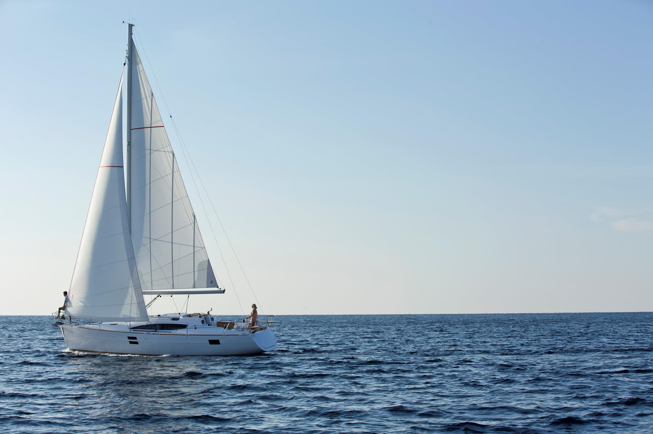
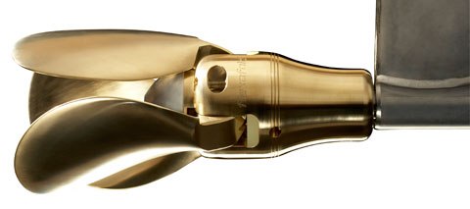
Fixed vs. low drag folding propeller
Mounting of a Flexofold propeller
Source: SSPA Maritime Consulting
Verified by Yachting Monthly´s on-water-test (2009).

Slide 7
Product philosophy
+

Slide 8
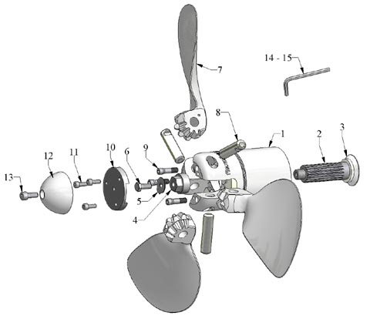
Product philosophy
Involvement of the boat owner:
Personal 1:1 dialogue
Technical support
Recommendation based on boat/engine and the boat owners personal preference
Easy mounting
Random blade position
Pre-applied with Loctite
Prepared for under water mounting
Easy maintenance
Water lubricated
Easy to clean
Very few spare parts

Slide 9
The Flexofold product range
2-blade folding propeller
3-blade folding propeller
4-blade folding propeller
All types available for both saildrive and shaft installation

Slide 10
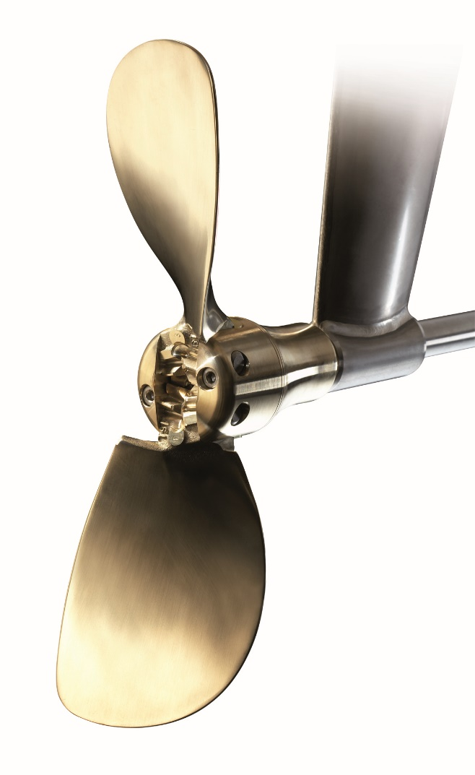
2-blade Flexofold Classic
Flexofold Classic
Available for both shaft and
saildrive installation
Diameter: 13-20”
Pitch: 4-7 different per
diameter

Slide 11
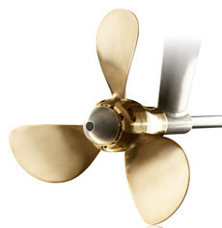
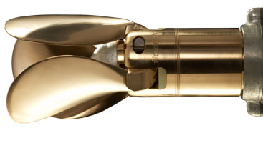
3-blade Flexofold Classic
For saildrive:
Diameter: 14-20”
Pitch: 4-7 different per diameter
100% fit with all saildrives
For shaft:
Diameter: 14-26”
Pitch: 4-7 different per diameter
100% fit on ISO/IMP/SAE

Slide 12
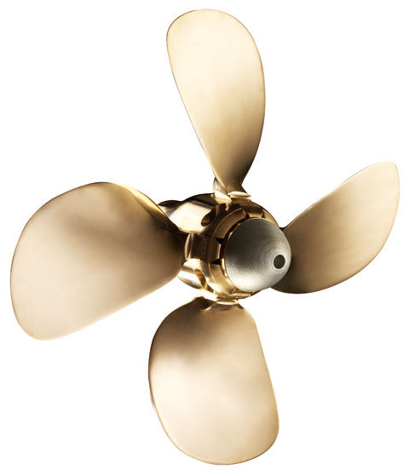
4-blade Flexofold Classic
For saildrive:
Diameter: 15-20”
Pitch: 4-7 different per diameter
100% fit on all common saildrives
For shaft:
Diameter: 15-27”
Pitch: 4-7 different per diameter
100% fit on ISO/IMP/SAE

Slide 13
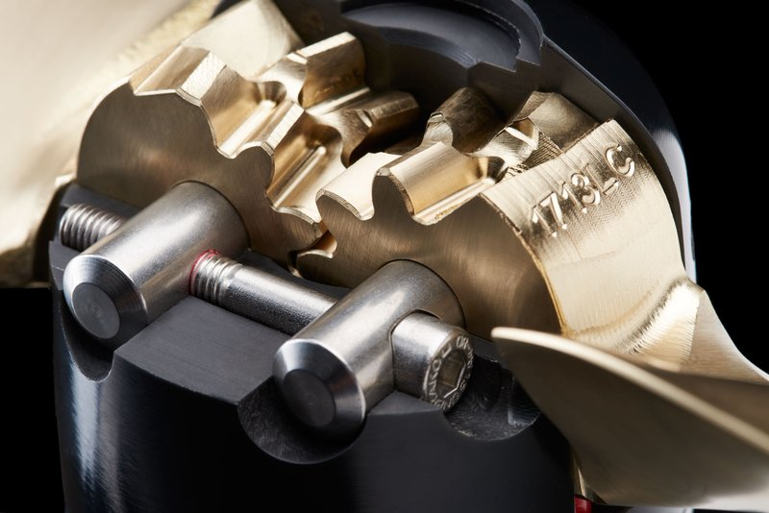
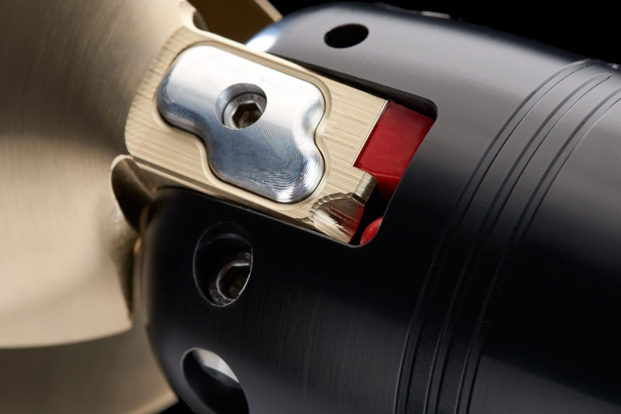
The new Flexofold Composite Propeller

Slide 14
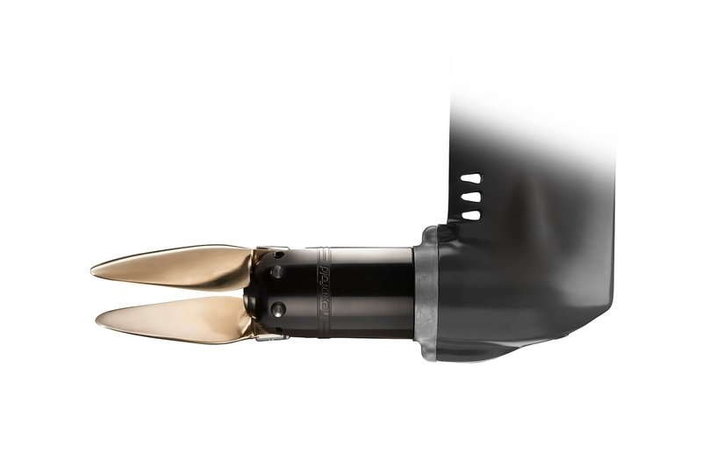
The new Flexofold Composite Propeller

Slide 15
Technical USP´s
Efficient / twisted blade profile
Double helical gearing
Special tapered locking screws
Strong shock absorbers
Only few moving parts
Water lubricated
Special inner hub for
protection of saildrive
and propeller
Closed gearing
100% test of dynamic balance
Ni/Al/Bronze

Slide 16
USP´s
Boat owner
Trust
Pers. advice
Fast delivery
After sales service
More joy
Higher speed
Better sailing
Easy control
Reliability
Strong propulsion power
3 year warranty
Comfort
No noise from turning propeller
Easy maintenance
Safety
Not catching ropes and lines

Slide 17
Flexofold warranty
3 year product warranty
Product life time warranty on shock absorbers
100% test of dynamic balance
100% following the ISO, IMP and SAE standards
100% fit with all common saildrives

Slide 18
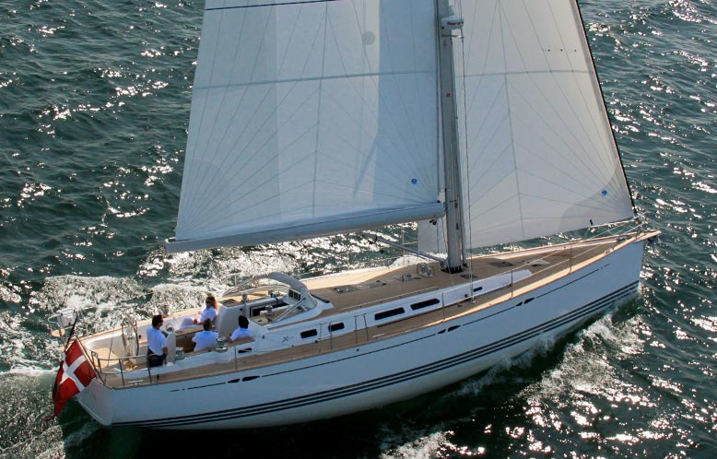
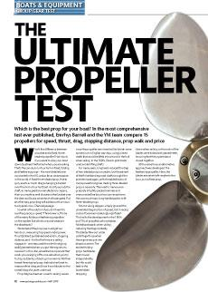
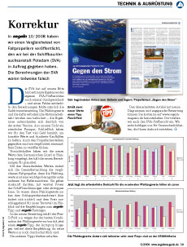
Independent tests
Notes:
Test by Yachting Monthly: "Highest top speed..."

Slide 19
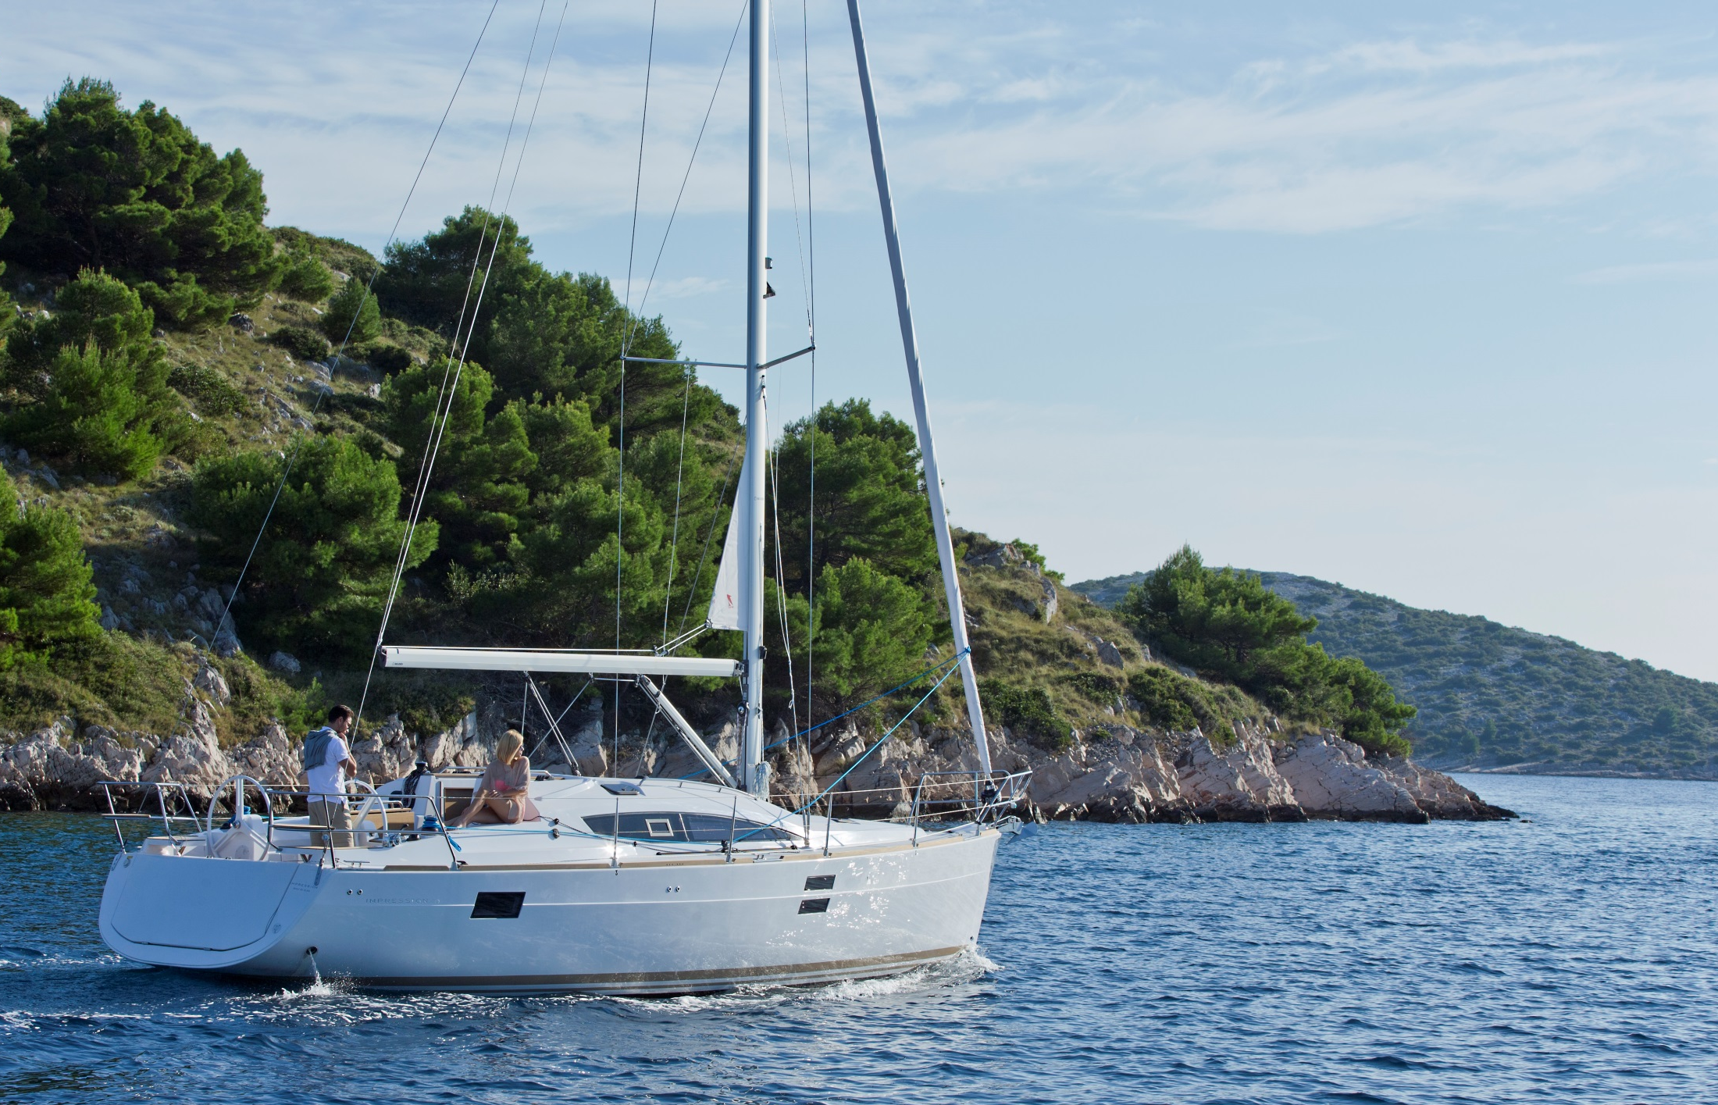
Notes:
More than half a knot difference in maximum speed between best and worst.
Flexofold 3-blade produces 38% more thrust than the worst perfoming propeller.

Slide 20
Factory shipping - worldwide

Slide 21
Our Boatyard coustomers
…and countless private boat owners worldwide!

Slide 22
Questions?
See more on
www.flexofold.com
and follow Flexofold on:

